Slide 1

PhD Image Holder
Trying to consolidate and structure everything under one location

Slide 2
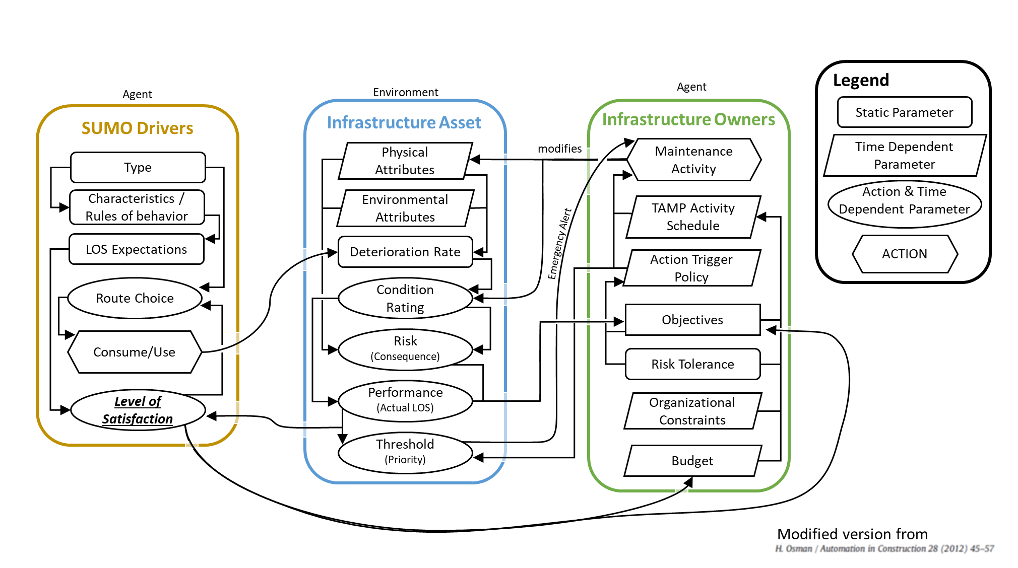
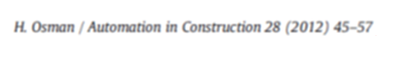
PhD Research - Agents and Roadway (environment) Dynamics
Agent
Legend
Agent
Environment
Infrastructure Asset
Infrastructure Owners
Static Parameter
SUMO Drivers
Physical Attributes
modifies
Maintenance Activity
Time Dependent Parameter
Type
Action & Time Dependent Parameter
Characteristics / Rules of behavior
Environmental Attributes
TAMP Activity Schedule
LOS Expectations
Deterioration Rate
Emergency Alert
ACTION
Action Trigger Policy
Route Choice
Condition Rating
Objectives
Consume/Use
Risk (Consequence)
Risk Tolerance
Level of Satisfaction
Performance
(Actual LOS)
Organizational Constraints
Threshold
(Priority)
Budget
Modified version from

Slide 3
PhD Research - Agents and Roadway (environment) Dynamics
Agent
Legend
Agent
Environment
Infrastructure Asset
Infrastructure Owners
Static Parameter
SUMO Drivers
Physical Attributes
modifies
Maintenance Activity
Time Dependent Parameter
Type
Action & Time Dependent Parameter
Characteristics / Rules of behavior
Environmental Attributes
TAMP Activity Schedule
LOS Expectations
Deterioration Rate
Emergency Alert
ACTION
Action Trigger Policy
Route Choice
Condition Rating
Objectives
Consume/Use
Risk (Consequence)
Risk Tolerance
Level of Satisfaction
Performance
(Actual LOS)
Organizational Constraints
Threshold
(Priority)
Budget
Modified version from

Slide 4
Agent
Legend
Network Demand
Virtual Network
Infrastructure Asset
Infrastructure Owners
Static Parameter
SUMO Drivers
Physical Attributes
modifies
Maintenance Activity
Time Dependent Parameter
Type
Action & Time Dependent Parameter
Characteristics / Rules of behavior
Environmental Attributes
TAMP Activity Schedule
LOS Expectations
Deterioration Rate
Emergency Alert
ACTION
Action Trigger Policy
Route Choice
Condition Rating
Objectives
Consume/Use
Risk (Consequence)
Risk Tolerance
Level of Satisfaction
Performance
(Actual LOS)
Organizational Constraints
Threshold
(Priority)
Budget
Relationship Visualization concept from:
H. Osman / Automation in Construction 28 (2012) 45-57

Slide 5
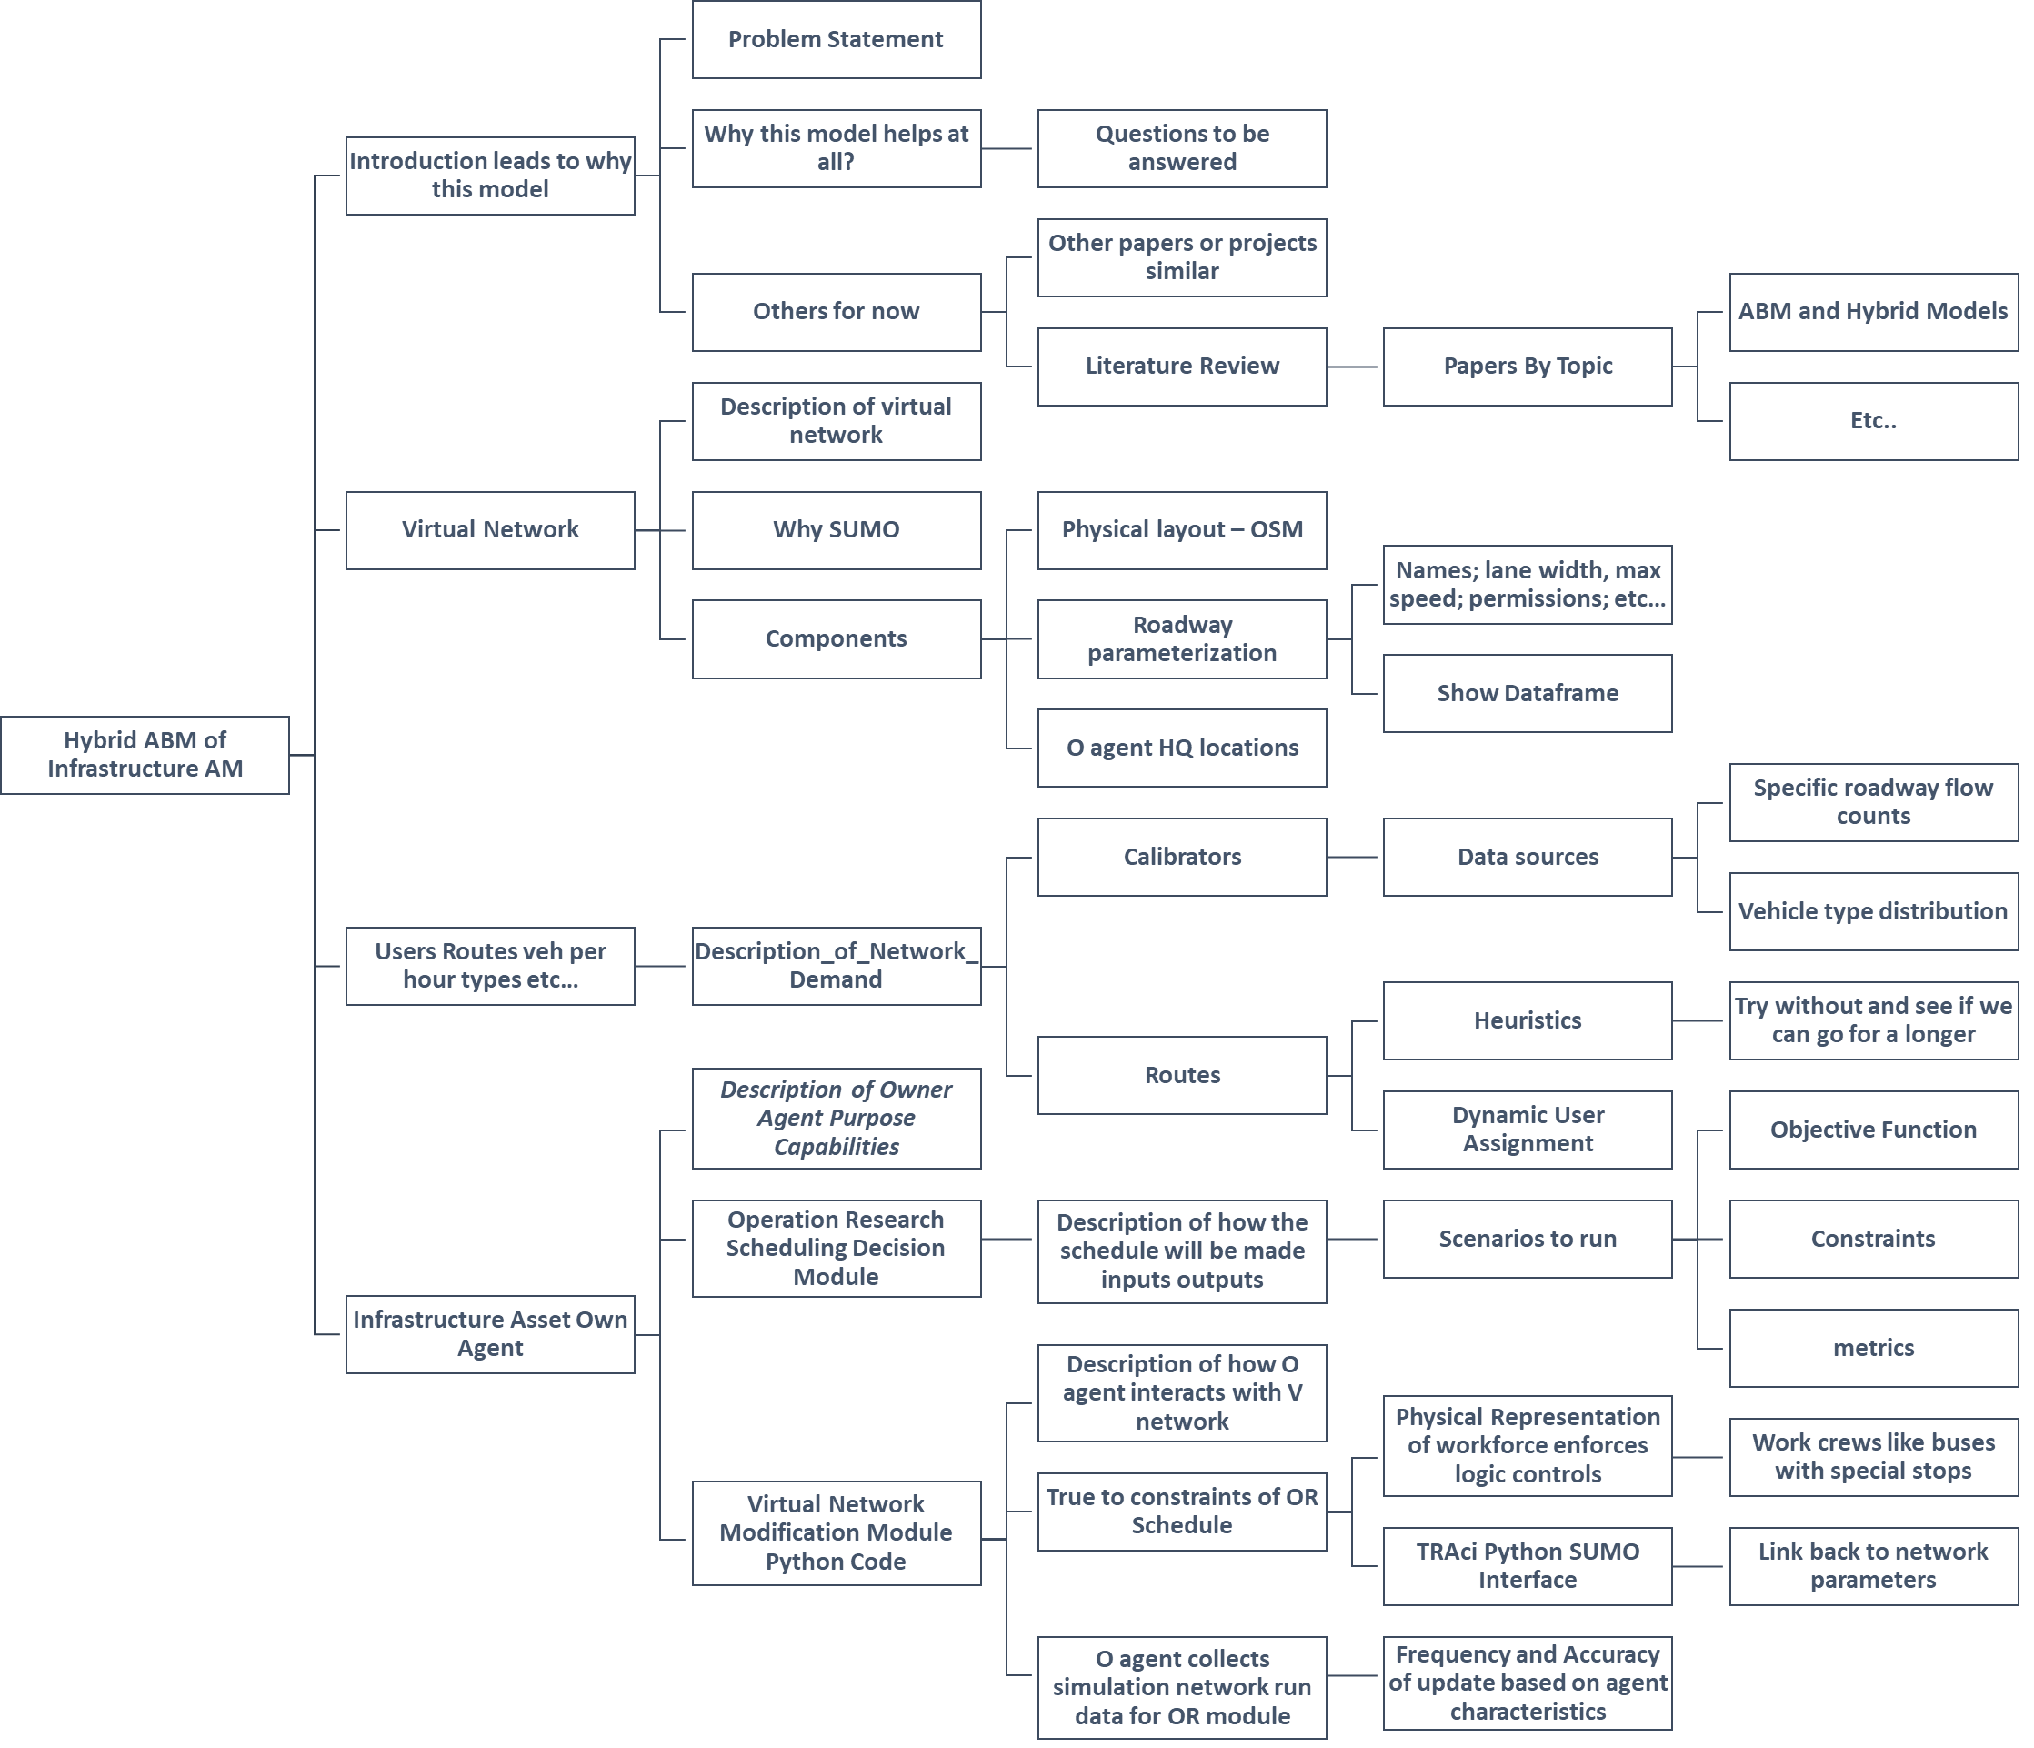

Slide 6
Introduction and Background Info
Problem Statement
Why this model helps at all?
Questions to be answered
Introduction leads to Why this Model is Relevant?
Transportation Asset Management
Very relevant papers or projects
Background and Literature Review
ABM and Hybrid Models
Literature Review
Papers By Topic
Etc..
Hybrid ABM of Infrastructure AM
Description of virtual network
Virtual Network
Why SUMO
Physical layout – OSM
Names; lane width, max speed; permissions; etc…
Components
Roadway parameterization
Show Dataframe
O agent HQ locations
Specific roadway flow counts
Description_of_Network_Demand
Users
Routes
veh per hour
types
etc…
Calibrators
Data sources
Vehicle type distribution
Network Demand
Users Behavior
Heuristics
Try without and see if we can go for a longer
Routes
Dynamic User Assignment
Description of Owner Agent Purpose Capabilities
Objective Function
Operation Research Scheduling Decision Module
Description of how the schedule will be made inputs outputs
Scenarios to run
Constraints
Infrastructure Asset Own Agent
Description of how O agent interacts with V network
metrics
Physical Representation of workforce enforces logic controls
Work crews like buses with special stops
Virtual Network Modification Module Python Code
True to constraints of OR Schedule
TRAci Python SUMO Interface
Link back to network parameters
O agent collects simulation network run data for OR module
Frequency and Accuracy of update based on agent characteristics

Slide 7
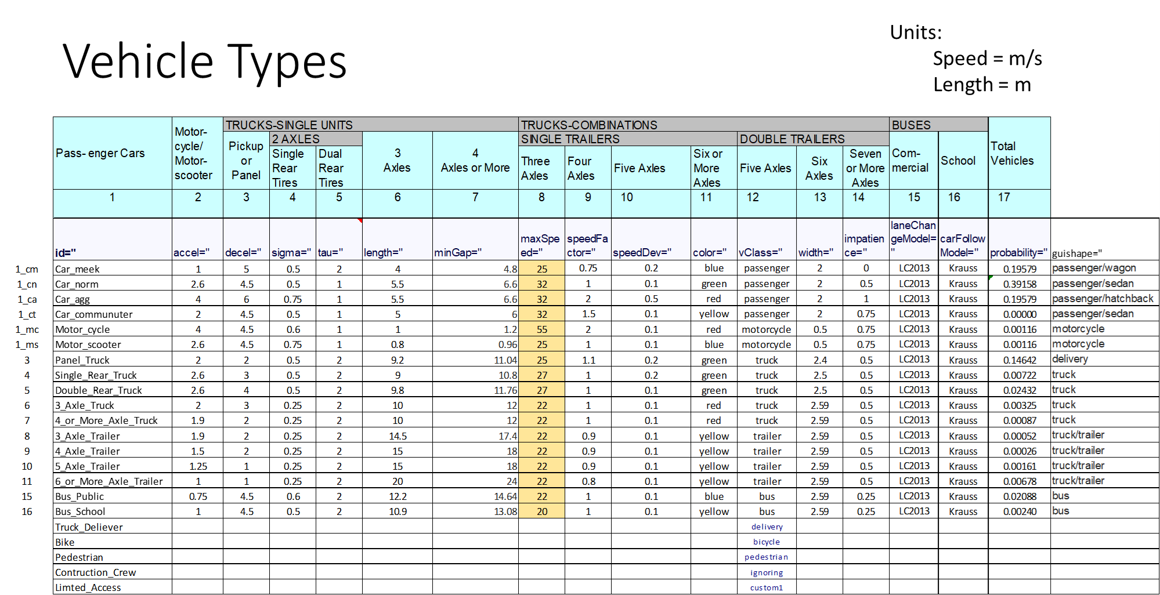
Vehicle Types
Units:
Speed = m/s
Length = m

Slide 8
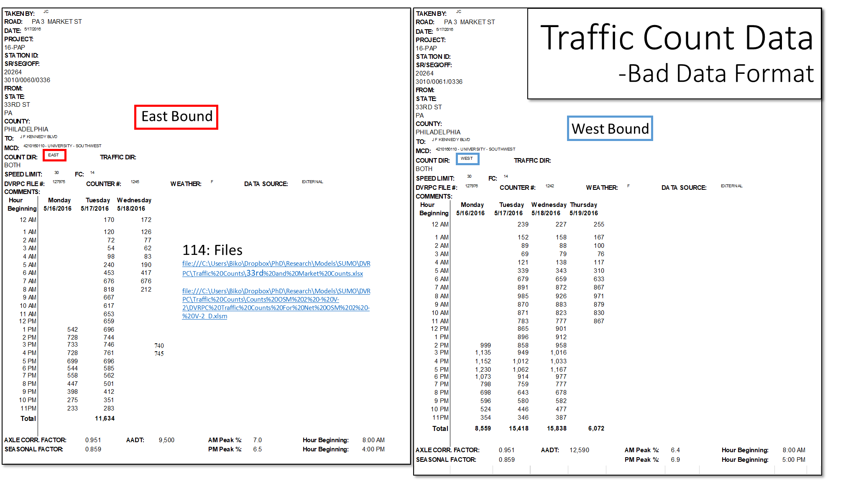
Traffic Count Data -Bad Data Format
East Bound
West Bound
114: Files
file:///C:\Users\Biko\Dropbox\PhD\Research\Models\SUMO\DVRPC\Traffic%20Counts\33rd%20and%20Market%20Counts.xlsx
file:///C:\Users\Biko\Dropbox\PhD\Research\Models\SUMO\DVRPC\Traffic%20Counts\Counts%20OSM%202%20-%20V-2\DVRPC%20Traffic%20Counts%20For%20Net%20OSM%202%20-%20V-2_D.xlsm

Slide 9
DVRPC – Manual Class Distribution
http://www.dvrpc.org/webmaps/TrafficCounts/ - Output is only PDF.
file:///C:\Users\Biko\Dropbox\PhD\Research\Models\SUMO\DVRPC\Traffic%20Counts\PennDOT%20Traffic%20Class%20Distributions.xlsm

Slide 10
West Philadelphia SUMO Model – 8.23.17
Maybe

Slide 11

The SUMO Simulation
3
External Database
Asset Information
Asset Profile; including-> Max Speed(condition/Capacity)
Population Generation and Activity Plan - Fixed
DVRPC House Hold Survey Data Generated Trips
DVRPC Traffic Flow Detector Data Generated Trips
Routing Algorithm:
Minimization of travel time.
Max speed on a road is based on density and condition
SUMO - Simulation
Car Following Model Parameters - Fixed
Potential Outputs:
queue-output - Save the vehicle queues at the junctions (experimental)
summary-output - Save aggregated vehicle departure info
tripinfo-output - Save single vehicle trip info
vehroute-output - Save single vehicle route info into
exit-times - Write the exit times for all edges
Sorted - Sorts the output by departure time
intended-depart - Write the output with the intended instead of the real departure time
route-length - Include total route length in the output;
lanechange-output - Record lane changes and their motivations for all vehicles
Link-output - Save links states
---Wiki-LINK---
Notes:
http://sumo.dlr.de/wiki/Simulation/Output

Slide 12
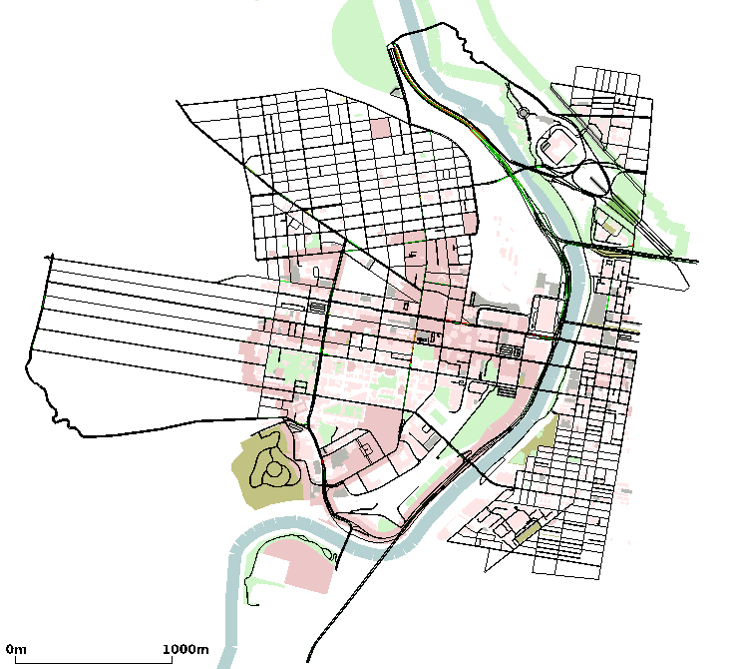
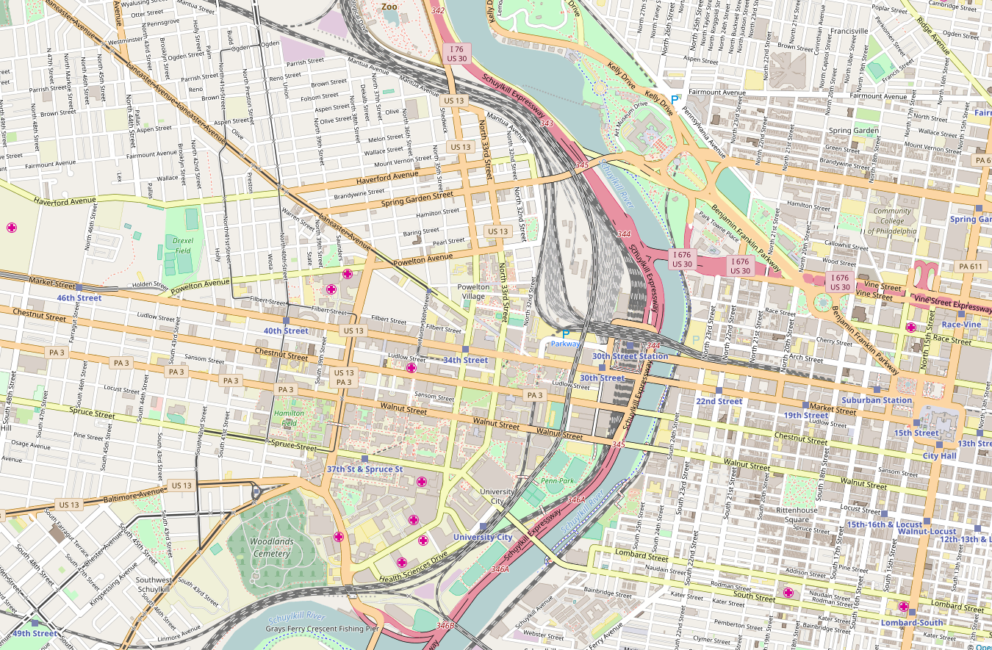
Development of AOI
Area of interest (AOI) within SUMO has been established to include Powelton Village, University City, and segments of other neighborhoods just across the Schuylkill River.
SUMO’s network topology was created with the assistance of Open Street Maps (OSM),
An open source mapping database that maintains data on roads, public transit, trails, points of interest, and many more. The critical information that is contained within the database, for this project is the details for each roadway segment.
Included in the SUMO platform is a tool to directly can import most of the OSM data to construct a functional SUMO network.
https://www.openstreetmap.org/export#map=15/39.9557/-75.1832
SUMO - Network File

Slide 13
SUMO Simulation - General Flow
1
2
Network
Junctions
Stop sign or Traffic Light or Priority Stop
Edges
Lane
Width, Permission, Max Speed, Network Link Type
Additional Properties
Calibrator
Triggered Object
Adds or Removes per defined Vehicles per hour
DVRPC – Volume Data
Demand
DVRPC HH Survey Trip Demand with Calibrators
Vehicle Type distribution – DVRPC Class Data
Vehicle ID; Vehicle Type; Individual Vehicle Routes; Departure period
3
4
Simulation - .SUMOcnfg
Input:
Network File
Route File
vType File
Calibrator definitions
Shape Files – for Buildings and Places of interest
OutPuts: ---LINK---
queue-output
summary-output
tripinfo-output
vehroute-output
exit-times
sorted
intended-depart
route-length
lanechange-output

Slide 14
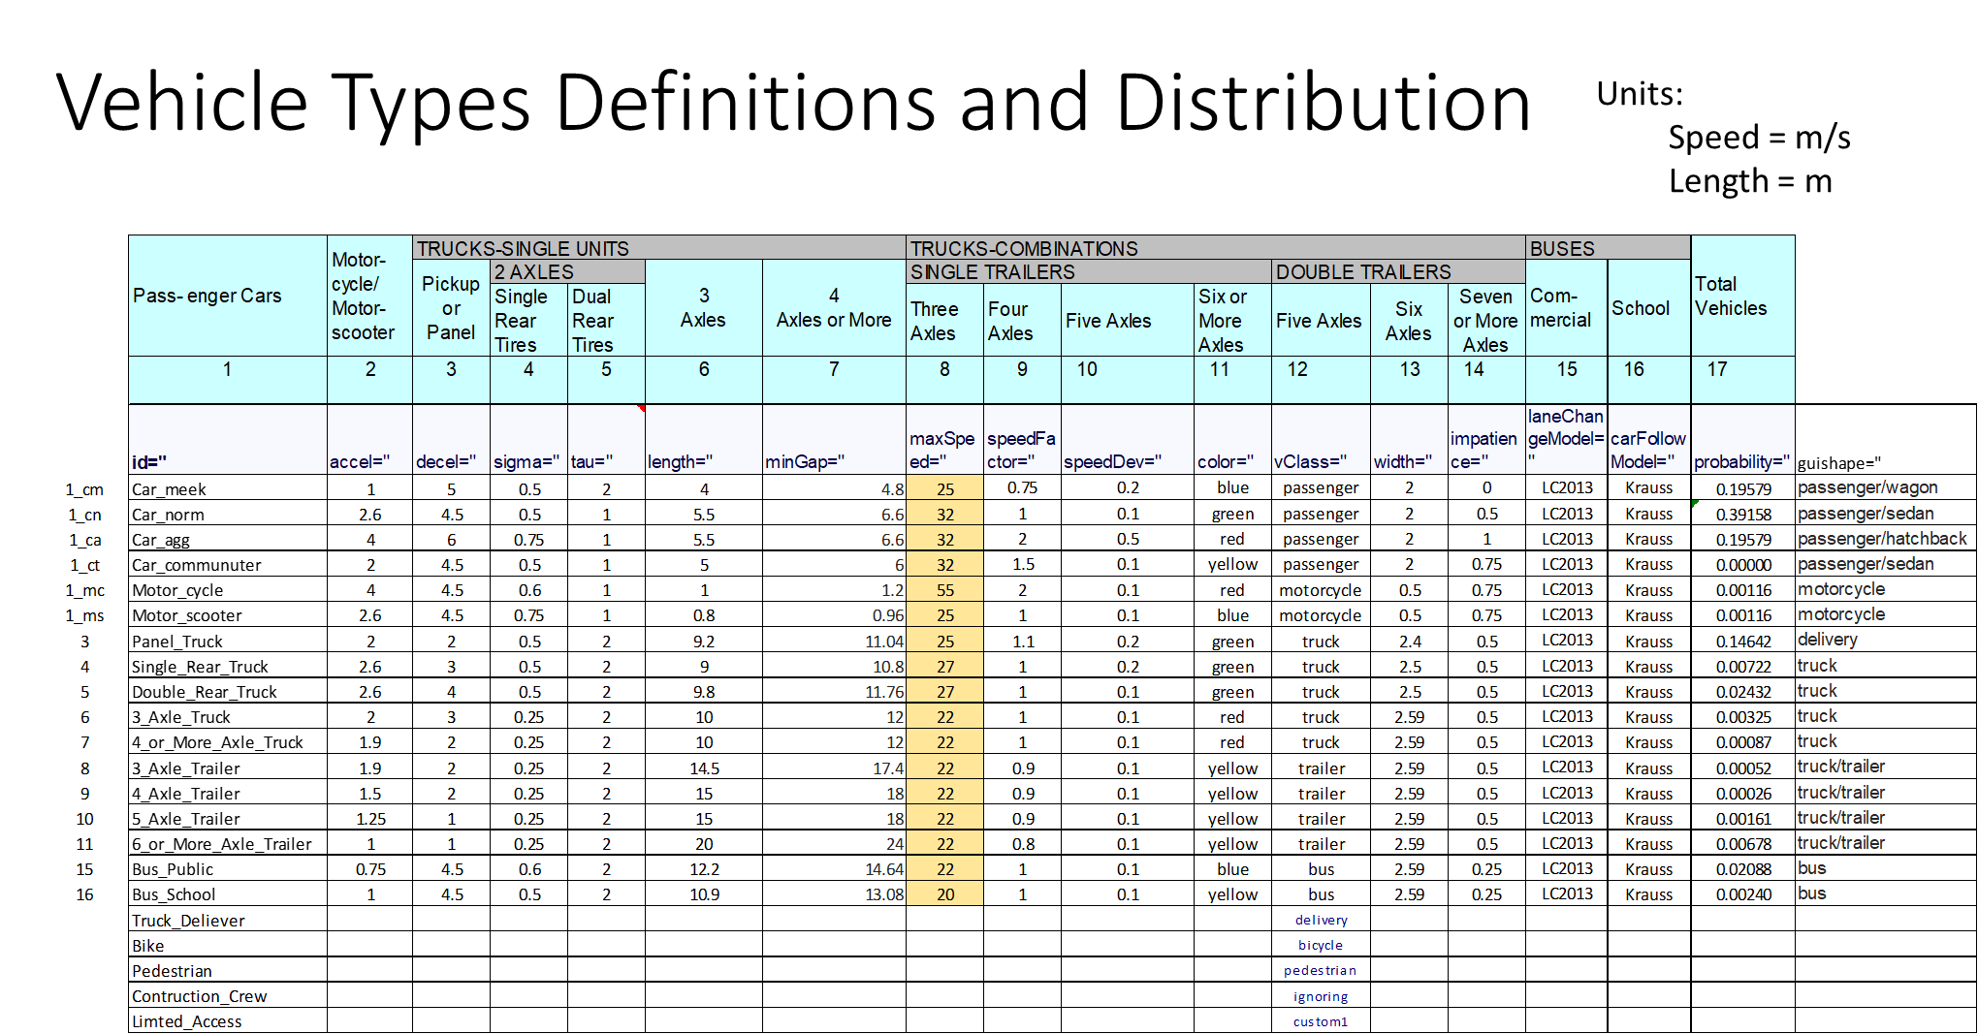
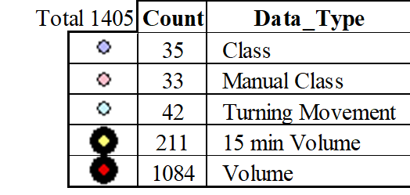
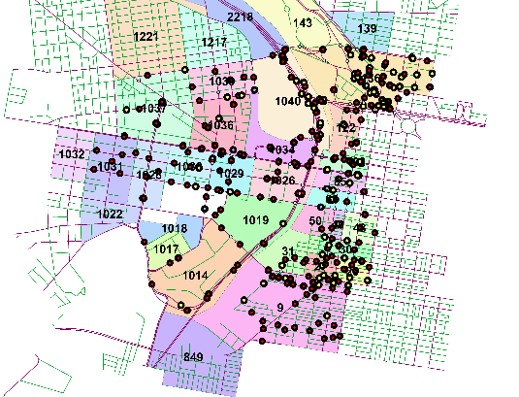
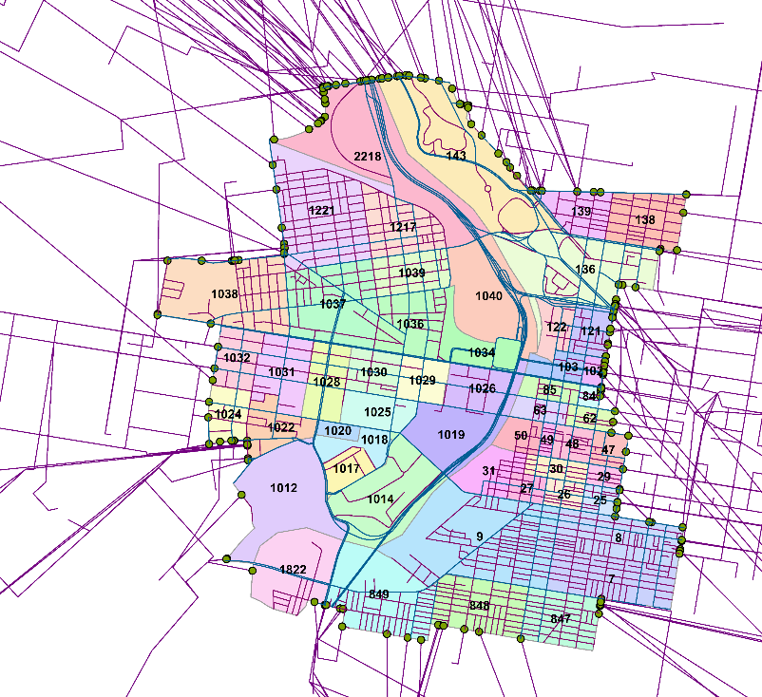
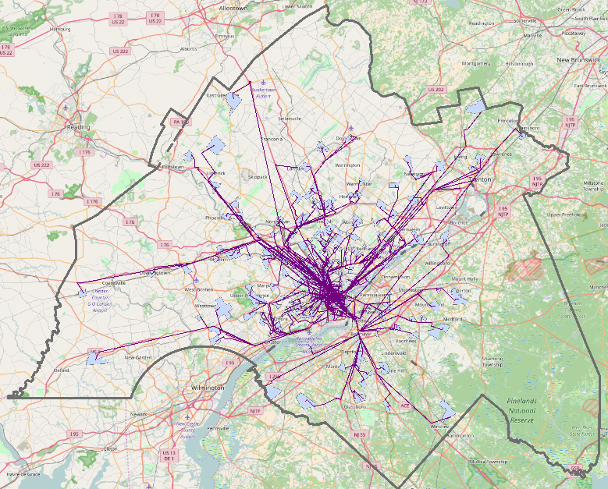
DVRPC Data Incorporated Into Sumo’s Traffic Demand
DVRPC Traffic Count and Manual (vehicle) Class has been incorporated into SUMO as traffic demand and vehicle type distributions
Each traffic count data set is translated into SUMO be creating a route probe and corresponding calibrator
95% - completed, but now the process is semi-automated and completion is expected by the 18th of September
SUMO –Route Probe and Calibrator File
Vehicle type distribution – from 14 Manual Class Data Points
Incorporated the DVRPC House Hold Trip Survey Data that either originated or ended within the AOI (97%)
Used Python Gmap Module to generate directions for trips into, out of, and within the AIO (1700+) → Map the turn-by-turn GPS coordinates from Google Directions with GIS → Use GIS to associate routes that entered or exited the AOI with the corresponding perimeter TAZ → Modified the DVRPC trips to their new origin or destination TAZ within the AOI → Create a SUMO Trip file with original departure times → Generate vehicles and routes for each trip
DVRPC Traffic Count Data
Notes:
https://www.dropbox.com/s/h7y28db3f12calv/DVRPC Traffic Counts For Net OSM 2 - V-3 9.1.xlsb.xlsx?dl=0
https://www.dropbox.com/s/709opumzrtlf6ys/GIS_TAZ_to_TAZ_All.png?dl=0

Slide 15

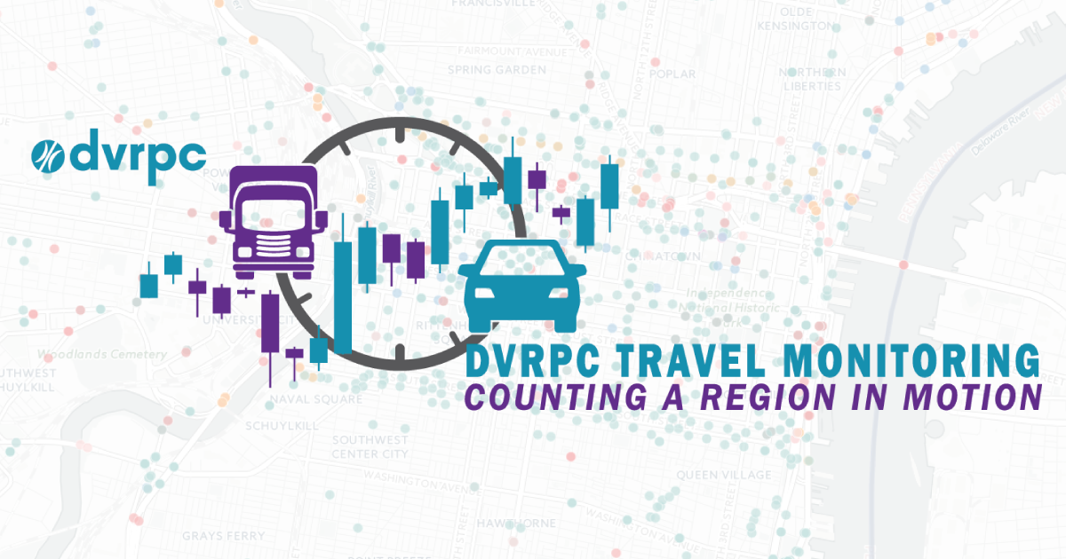
DVRPC – Data and Methods to Incorporate into SUMO

Slide 16
DVRPC – House Hold Trip Surveys
Household travel surveys are used to obtain information about work and non-work trip generation, trip distribution, modal split, and average vehicle occupancy. Updated household travel information can be used for modeling purposes as well as transportation planning projects such as high occupancy vehicle lanes, bicycle, and pedestrian studies, welfare-to-work programs, and traffic control studies.
Each trip contains an origin and destination Traffic Analysis Zone (TAZ), more on the next slide.
http://www.dvrpc.org/Transportation/Modeling/Data/

Slide 17
Incorporating DVRPC HH Trip Survey Data into SUMO
There are 3,158 TAZs located within DVRPC’s jurisdiction
The AOI for this project contains ~50 TAZs (some changes to the SUMO TAZ definitions need to be made for more robust routing results)
To utilize the DVRPC’s trip data the trips containing any of the TAZs within the AOI need to be extracted.
Some of the TAZs will fall outside the AOI and need to be mapped to their entry or exit TAZ.
The Lat and Long coordinates of each TAZs’ centroid are identified with GIS.
Each trip is associated with the coordinates of its Origin and Destination
Each trip is sent to Google Maps utilizing Python-Gmap Module.
The turn by turn results are processed and sent back to GIS
Each trip’s route is then associated with an AOI edge TAZ
The original trips are then modified to include their corresponding edge AOI
The modified trips definitions are formatted into a SUMO useable code:
<trip id="65309" depart="0" fromTaz="TAZ-1032” toTaz="TAZ-1038"/>
Where the trip id corresponds to the DVRPC HH survey and reported departure time
Notes:
C:\Sumo\runs\West_Philly\OSM_Clipped_Vtype_Routes\OSM_Clipped_TAZ_FULLish.trip.xml

Slide 18
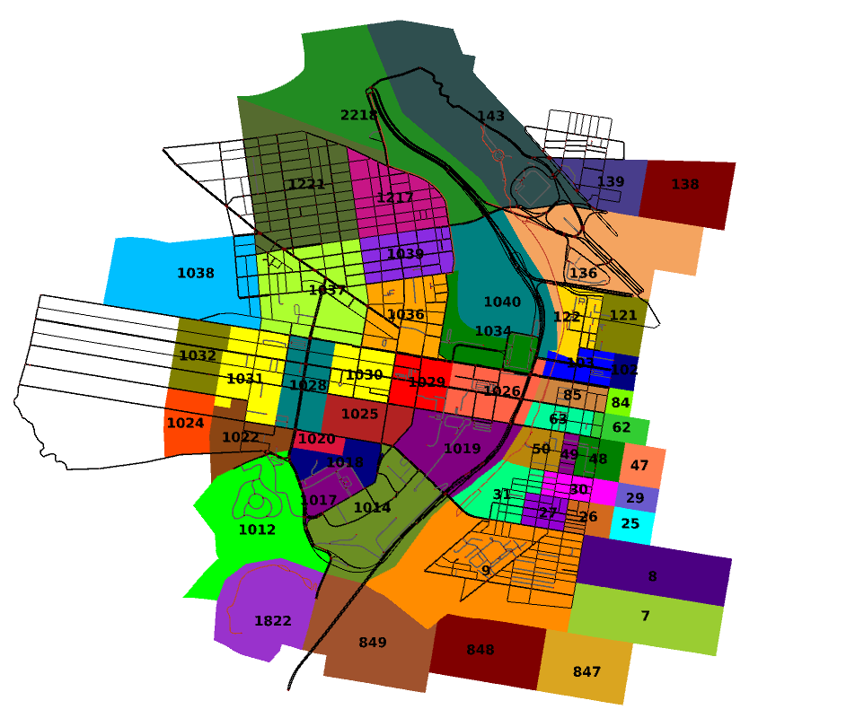
Defining TAZs in SUMO
Defined in SUMO as:
<taz id="TAZ_ID>" edges=“<Road_ID> <Road_ID> .../>
TAZ polygons are imported from GIS into the SUMO network.
The roads are carefully selected within each polygon, incorporating any roads on the northern and eastern edges.
The selected roads are then saved as TAZ-####
Some TAZs have limited roadways, which causes trouble during the routing phase.
These smaller TAZs are combined with their neighbors
Combining TAZs should be done in conjunction with the GIS TAZ mapping phase

Slide 19

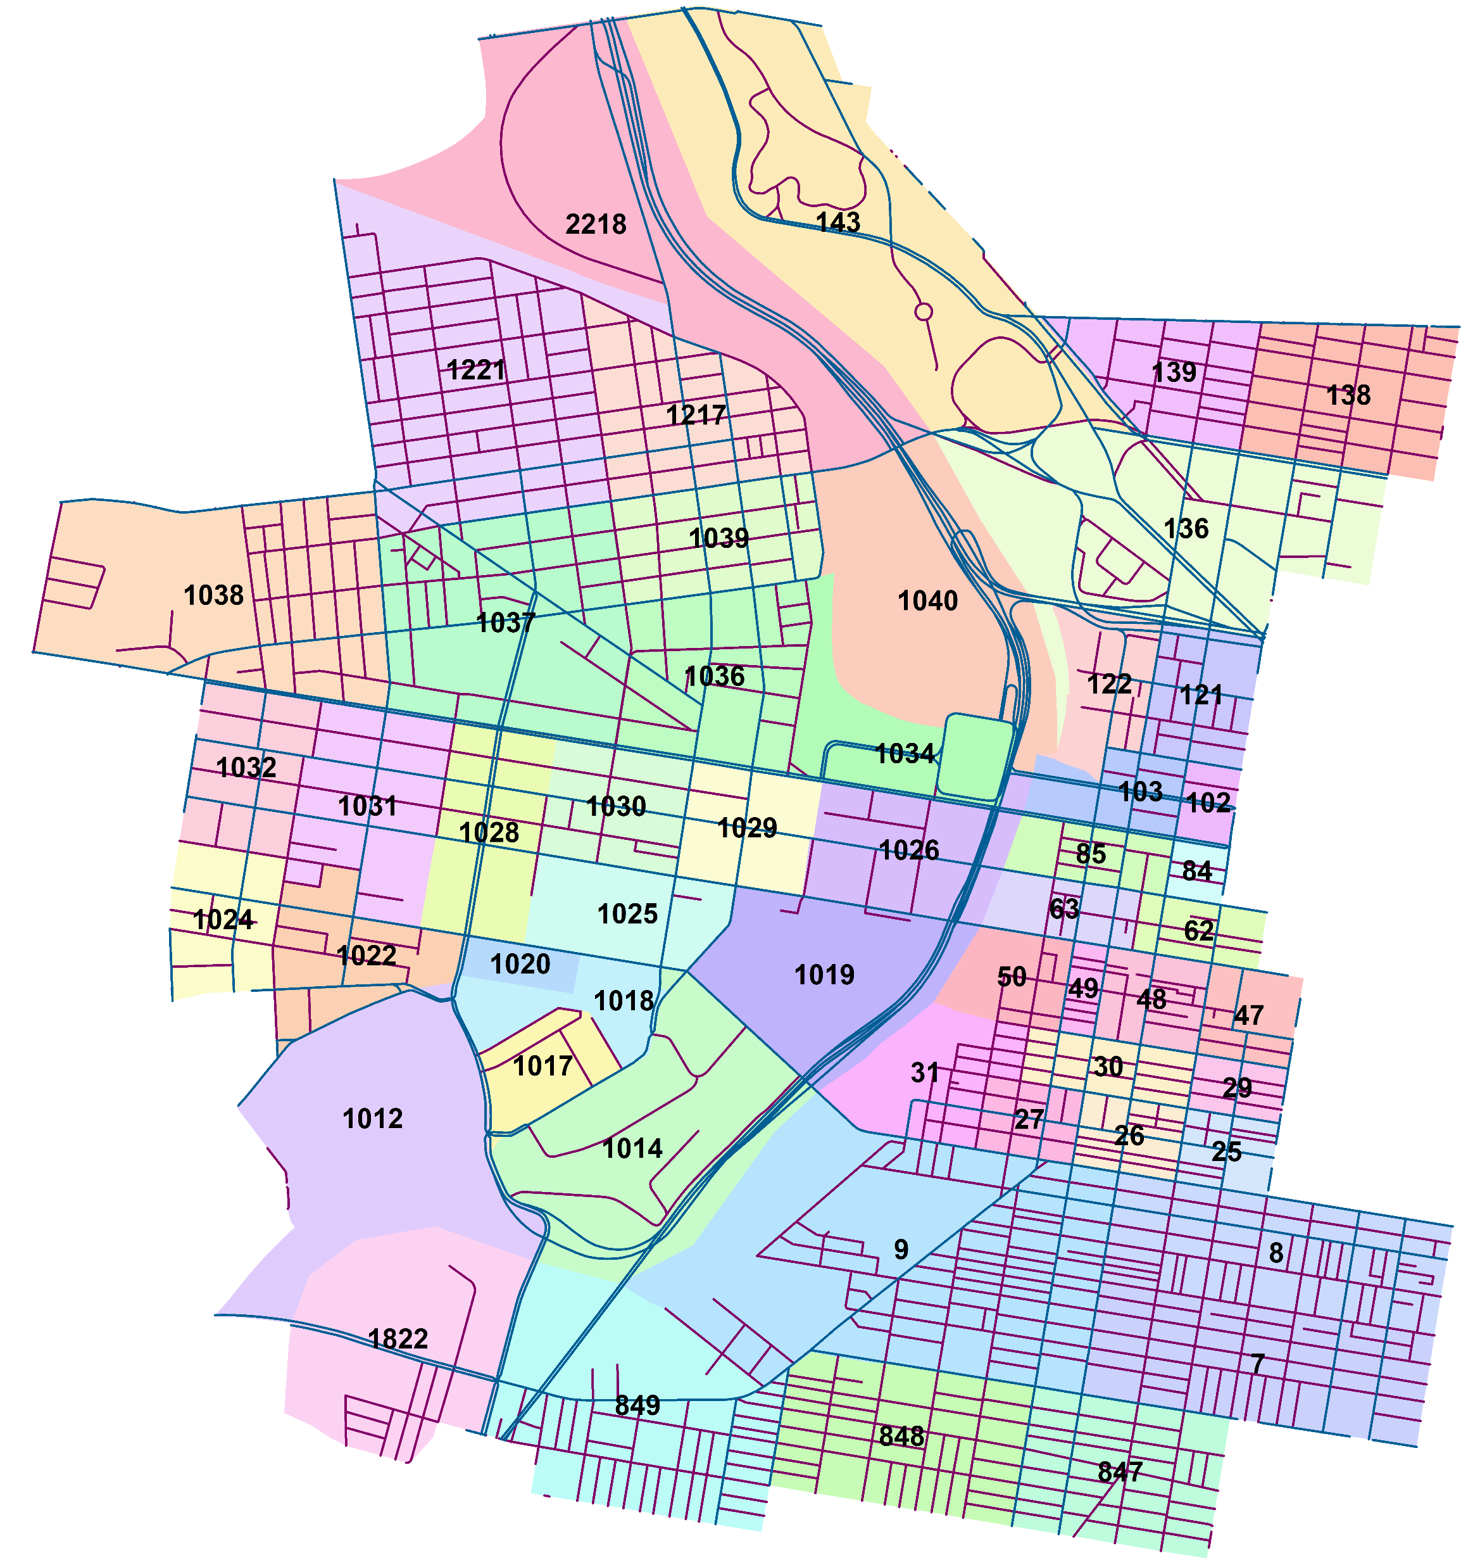

Mapping TAZs- From outside the AOI to the edges
Notes:
file:///C:\Users\Biko\Dropbox\PhD\Research\Models\SUMO\DVRPC\TAZ\Traffic_Count_TAZ_SpatialJoin_1.xlsx

Slide 20
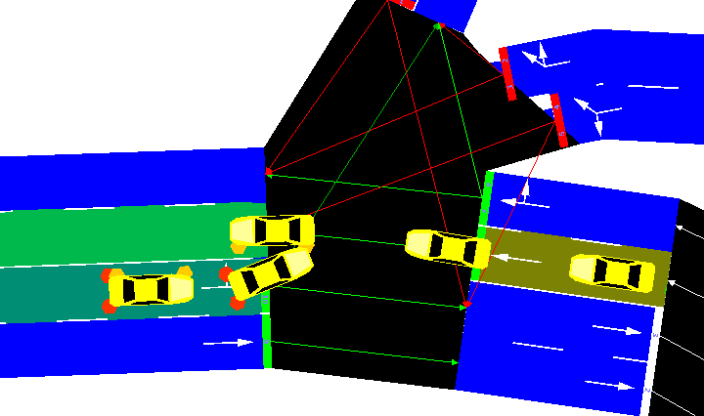
Accidents Happen…
SUMO Simulation Accident Options
--ignore-accidents <BOOL> | Do not check whether accidents occur; default: false
--collision.action <STRING> | How to deal with collisions: [none,warn,teleport,remove]; default: teleport
--collision.stoptime <TIME> | Let vehicle stop for TIME before performing collision.action (except for action 'none')
--collision.check-junctions <BOOL> | Enables collisions checks on junctions; default: false

Slide 21


DVRPC Traffic Models
The following information tries to layout how DVRPC builds and runs their traffic models.

Slide 22
VISUM – Functionality
PTV Visum Functions
Network modelling
Demand calculations
PrT assignment procedures
PuT assignment procedures and operations
Traffic engineering
Create analyses and reports
Interfaces
Used by Dr. Pradhan’s PhD Student
“Dongle” is active, but no support is available
Educational / Researcher’s License
$1,950 – one-time purchase
2 year – technical support
Includes Visum, Visim, Viswalk
Notes:
Contacted DR. RYERSON (@UPENN) to see if she can use VISUM to generate the TAZ to TAZ O/D Matrix.
-No response yet

Slide 23
Bridge Division Tasks first pass
Plans, Specifications, and Estimates
Streets Dep.
Tasks
Contractors
Bridge
Division
Electrical Construction & Maintenance (?)
Information Requests
Highway
Division
Claims and
Lawsuits
Asset Management
PS&E
Drawing Review (other deps)
Bids
Construction
Contractors -> Chris -> Verify with Owners -> Plans -> Contractor
Inspections
Street’s assets
Other agencies’ assets
Plant inspection
PennDOT inspected
Special access required
Special tools required
Quality Control - audit
Tech Support
Load Rating
Permits
EC&M
Oversized vehicles
Overweight vehicles
Sheeting shoring
Crain placement –
citywide
Commerce or Fairmount park
Dictates products by funding
Either City, State, or Federally owned
Mandates requirements and standards to be followed
If State does not support the City then the City pays 100%
Needs to be updated to reflect TK527
TK527 is a logging truck. Not very applicable to Philadelphia since the fracking trucks do not come this way, but PennDOT is requiring it
Project and rating primer / refresher
Pedestrian bridges are rated for emergency services and maintenance vehicles
Emergency Repairs
Able to work with PennDOT
Emergency repairs needed when:
Asked by the State, SD/FO, requests for compliance
Fractural Critical (< 4 stringers)
The department of streets are technical (Engineering) experts for most of the City’s other departments for structures

Slide 24
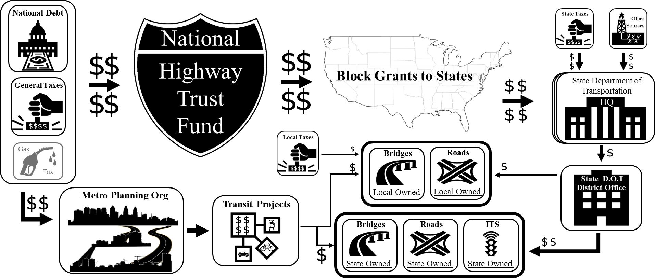


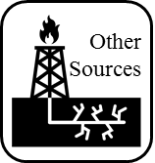

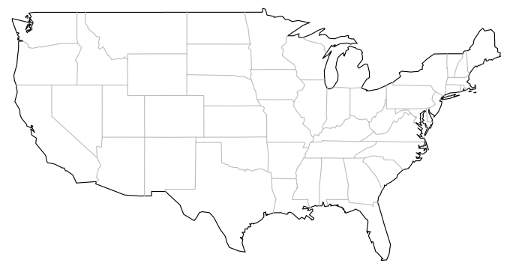









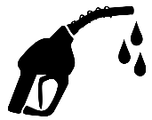


















How Does the Money Flow into State and Local Bridges?
National Debt
National
Highway
Trust Fund
Block Grants to States
General Taxes
Gas
Bridges
Roads
Tax
Metro Planning Org
Local Owned
Local Owned
Transit Projects
Bridges
Roads
ITS
State Owned
State Owned
State Owned

Slide 25
Life-Cycle Asset Management Activities
5 - Operations And Maintenance – Example of Activities
Performance Monitoring
Planned Maintenance
Service Delivery
Unplanned Repairs
Condition Monitoring
Demand Forecasting
Deterioration Modelling
Supply Chain Requirements
6
1
Inception
Feasibility Appraisals for Whole-Life Options
Planning and Design
Construction and Handover
Operations and Maintenance
Renewal or Disposal
Damage and Disruptions from Hazards
Deferred Maintenance
Heavy Traffic
Asset Management
Civil Infrastructure General Asset Life-Cycle Phases
(Hooper et al. 2009)
5
2
6 - Renewal or Disposal - Example of Activities
Performance Audit
Improvement And Upgrade
Replacement
Closure
Decommissioning
Deconstruction, Demolition And Recycling
Sale
Transfer Or End Of Liabilities
4
3
Notes:
Hooper, R., Armitage, R., Gallagher, A., & Osorio, T. (2009). Whole-life infrastructure asset management: good practice guide for civil infrastructure. Construction Industry Research and Information Association report C, 677.

